Slide 1
Run-Time Environments (P.389)
How do we allocate the space for the generated target code and the data object of our source programs?
The places of the data objects that can be determined at compile time will be allocated statically.
But the places for the some of data objects will be allocated at run-time.
The allocation of de-allocation of the data objects is managed by the run-time support package.
run-time support package is loaded together with the generate target code.
the structure of the run-time support package depends on the semantics of the programming language (especially the semantics of procedures in that language).

Slide 2
Procedure Activations
An execution of a procedure starts at the beginning of the procedure body.
When the procedure is completed, it returns the control to the point immediately after the place where that procedure is called.
Each execution of a procedure is called as its activation.
Lifetime of an activation of a procedure is the sequence of the steps between the first and the last steps in the execution of that procedure (including the other procedures called by that procedure).
If a and b are procedure activations, then their lifetimes are either non-overlapping or are nested.
If a procedure is recursive, a new activation can begin before an earlier activation of the same procedure has ended.

Slide 3
Cont.
Activation or liveness analysis is used for variables
Functions or procedures have more complex activation behaviour
Problem: functions can be recursive
This means each function activation has to keep it’s locals and parameters distinct

Slide 4
Activation Trees (P.391)
An activation of a function is a particular invocation of that function
Each activation will have particular values for the function parameters
Each activation can call another activation before it becomes inactive
The sequence of function calls can be represented as an activation tree
Notes:
Activation tree depicts the way control enters and leaves activations.
invocation (法规、条文等的)援引;

Slide 5
Activation Tree (cont.)
We can use a tree (called activation tree) to show the way control enters and leaves activations.
In an activation tree:
Each node represents an activation of a procedure.
The root represents the activation of the main program.
The node a is a parent of the node b iff the control flows from a to b.
The node a is left to to the node b iff the lifetime of a occurs before the lifetime of b.

Slide 6
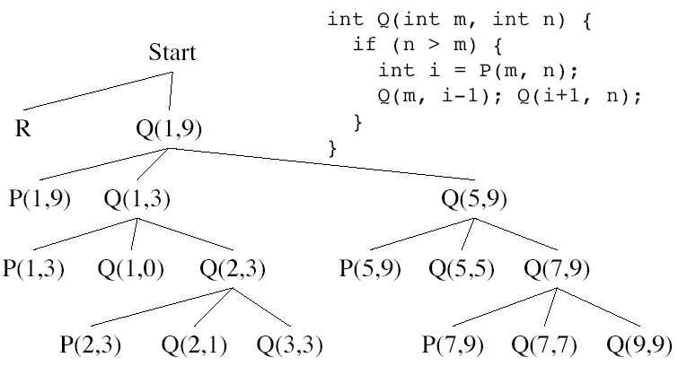
Activation Tree (cont.)
Fig.7.3 An activation tree corresponding to the output in Fig.7.2 P.393

Slide 7
Activation Tree (cont.)
program main; enter main
procedure s; enter p
begin ... end; enter q
procedure p; exit q
procedure q; enter s
begin ... end; exit s
begin q; s; end; exit p
begin p; s; end; enter s
exit s
exit main
A Nested Structure

Slide 8
Control Stack (P.393)
The flow of the control in a program corresponds to a depth-first traversal of the activation tree that:
starts at the root,
visits a node before its children, and
recursively visits children at each node an a left-to-right order.
A stack (called control stack) can be used to keep track of live procedure activations.
An activation record is pushed onto the control stack as the activation starts.
That activation record is popped when that activation ends.
When node n is at the top of the control stack, the stack contains the nodes along the path from n to the root.

Slide 9
Cont.
Control stack keeps track of live procedure activation.
The idea is to push the node for an activation onto the control stack as the activation begins and to pop the node when the activation ends.
s
r
q(1,9)
p(1,9)
q(1,3)
p(1,3)
q(1,0)
q(2,3)
Fig. 7.4 The control stack contains nodes along a path to the root.

Slide 10
Variable Scopes
The same variable name can be used in the different parts of the program.
The scope rules of the language determine which declaration of a name applies when the name appears in the program.
An occurrence of a variable (a name) is:
local: If that occurrence is in the same procedure in which that name is declared.
non-local: Otherwise (ie. it is declared outside of that procedure)
procedure p;
var b:real;
procedure p;
var a: integer; a is local
begin a := 1; b := 2; end; b is non-local
begin ... end;

Slide 11
Run-Time Storage Organization
Memory locations for code are
determined at compile time.
Locations of static data can also be
determined at compile time.
Data objects allocated at run-time.
(Activation Records)
Other dynamically allocated data
objects at run-time. (For example,
malloc area in C).
Code
Static Data
Stack
Heap

Slide 12
Problems with Functions
If a function has local variables, and if it calls another function: what happens to locals after control returns
Recursive functions
Function can access non-local (global) variables
Parameters passing into a function
Can we pass functions as parameters?
Can functions be returned as the result of a function?
Storage allocation within a function?
Is de-allocation to be done by the programmer before leaving the function?
Dangling pointers?

Slide 13
Activation Records/Frame (P.398)
Information for a single execution of a function is called an activation record or procedure call frame
A frame contains:
Temporary local register values for caller
Local data
Snapshot of machine state (important registers, PC)
Return address (control link)
Link to global data (access link)
Parameters passed to function (actual parameters)
Return value for the caller

Slide 14
Activation Records (cont.)
The returned value of the called procedure is returned
in this field to the calling procedure. In practice, we may
use a machine register for the return value.
The field for actual parameters is used by the calling
procedure to supply parameters to the called procedure.
The optional control link points to the activation record
of the caller.
The optional access link is used to refer to nonlocal data
held in other activation records.
The field for saved machine status holds information about
the state of the machine before the procedure is called.
The field of local data holds data that local to an execution
of a procedure..
Temporay variables is stored in the field of temporaries.
return value
actual parameters
optional control link
optional access link
saved machine status
local data
temporaries

Slide 15
Activation Records (Ex1)
stack
main
p a:
q b:
program main;
procedure p;
var a:real;
procedure q;
var b:integer;
begin ... end;
begin q; end;
procedure s;
var c:integer;
begin ... end;
begin p; s; end;
main
p
s
q

Slide 16
Activation Records for Recursive Procedures
main
p
q(3) a: 3
q(2) a:2
q(1) a:1
program main;
procedure p;
function q(a:integer):integer;
begin
if (a=1) then q:=1;
else q:=a+q(a-1);
end;
begin q(3); end;
begin p; end;

Slide 17
Creation of An Activation Record (P.407)
Who allocates an activation record of a procedure?
Some part of the activation record of a procedure is created by that procedure immediately after that procedure is entered.
Some part is created by the caller of that procedure before that procedure is entered.
Who deallocates?
Callee de-allocates the part allocated by Callee.
Caller de-allocates the part allocated by Caller.

Slide 18
Creation of An Activation Record (cont.)
return value
actual parameters
optional control link
optional access link
saved machine status
local data
temporaries
Caller’s Activation Record
Caller’s Responsibility
return value
actual parameters
optional control link
optional access link
saved machine status
local data
temporaries
Callee’s Activation Record
Callee’s Responsibility

Slide 19
Variable Length Data
return value
actual parameters
Variable length data is allocated after
temporaries, and there is a link to from
local data to that array.
optional control link
optional access link
saved machine status
local data
pointer a
pointer b
temporaries
array a
array b

Slide 20
Access to Nonlocal Names (P.411)
Scope rules of a language determine the treatment of references to nonlocal names.
Scope Rules:
Lexical Scope (Static Scope)
Determines the declaration that applies to a name by examining the program text alone at compile-time.
Most-closely nested rule is used.
Pascal, C, ..
Dynamic Scope
Determines the declaration that applies to a name at run-time.
Lisp, APL, ...

Slide 21
Lexical Scope
The scope of a declaration in a block-structured language is given by the mostly closed rule.
Each procedure (block) will have its own activation record.
procedure
begin-end blocks
(treated same as procedure without creating most part of its activation record)
A procedure may access to a nonlocal name using:
access links in activation records, or
displays (an efficient way to access to nonlocal names)

Slide 22
Access Links
main access link a:
q(1) access link i,b:
q(0) access link i,b:
s access link c:
p access link d:
program main;
var a:int;
procedure p;
var d:int;
begin a:=1; end;
procedure q(i:int);
var b:int;
procedure s;
var c:int;
begin p; end;
begin
if (i<>0) then q(i-1)
else s;
end;
begin q(1); end;
Access
Links

Slide 23
Procedure Parameters
main
access link
program main;
procedure p(procedure a);
begin a; end;
procedure q;
procedure s;
begin ... end;
begin p(s) end;
begin q; end;
q
access link
p
access link
Access links must be passed with
procedure parameters.
s
access link

Slide 24
Storage organization (P.396)
The run-time storage might be subdivided:
Target code
Data object
Control stack
Heap
Object code
Static data
Stack
sp
Heap
Fig. 7.7 Typical subdivision of run-time memory into code and data areas.

Slide 25
Storage-allocation strategies
Three allocation strategies:
Static allocation lays out storage for all data objects at compile time.
Stack allocation manages the run-time storage as a stack.
Heap allocation allocates and de-allocates storage as needed at run time from a data area known as a heap.

Slide 26
Storage Allocation for Functions
Static Allocation
Layout all storage for all data objects at compile time
Essentially every variable is stored globally
But the symbol table can still control local activation and de-activation of variables
Very restricted recursion is allowed
Example: Fortran 77 program

Slide 27
Storage Allocation for Functions
Stack Allocation
Activation records are associated with each function activation
Activation records are pushed onto the stack when a call is made to the function
Storage for recursive functions is organized as a stack: last-in first-out (LIFO) order
Size of activation records can be fixed or variable
?

Slide 28
Storage Allocation for Functions
Stack Allocation
Sometimes a minimum size is required
Variable length data is handled using pointers
Storage for the locals is contained in the activation record for that call.
Locals are deleted after activation ends
Caller locals are reinstated and execution continues
Example: C, Pascal and most modern programming languages
Notes:
Reinstate 恢复

Slide 29
Storage Allocation for Functions
Heap Allocation
In some special cases stack allocation is not possible
If local variables must be retained after the activation ends
If called activation outlives the caller
Anything that violates the last-in first-out nature of stack allocation e.g. functions as return values

Slide 30
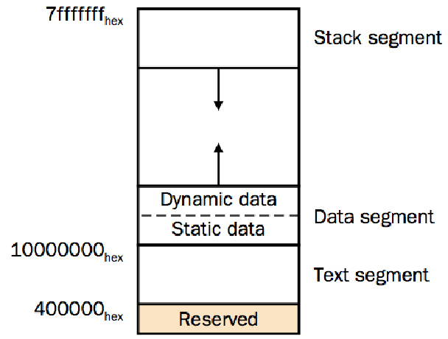
Run-time Memory (MIPS)

Slide 31
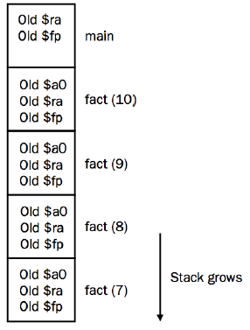
Stack for recursive functions
Recursive function is
used to calculate
factorial of n!:
fact(n)=n*fact(n-1)

Slide 32
Parameter Passing Conventions (P.424)
Differences based on:
The parameter represents an r-value (the rhs of an expr)
An l-value
Or the text of the parameter itself
Call by Value
Each parameter is evaluated
Pass the r-value to the function
No side-effect on the parameter
The caller places the actual parameters (r-values) in the storage for the formals

Slide 33
Parameter Passing Conventions
Call by Reference
Also called call by address/location
If the parameter is a name or expr that is an lvalue
then pass the l-value
else create a new temporary l-value and pass that
Typical example: passing array elements a[i]
The caller passes the called procedure a pointer to the storage address of each actual parameter
Notes:
1) 值传递call-by-value：最为常用。编译器将实参的计算值传递给形参。
2) 引用传递call-by-reference：常用。编译器将实参的地址传递给形参。
3) 值结果传递copy-restore, value-result：不常用。编译器在调用过程时将实参的值传递给形参，而在返回时将形参的值再传回给实参。
4) 名字传递call-by-name：少用。编译器在调用过程时并不马上建立形参与实参的联系，而只有在被调用过程中使用到形参时才动态地建立起与实参的联系。而且这种联系即不是传值，也不是传地址，而是类似于“宏替换”一样的对形参进行形式上的整体替换。它可能产生意想不到的结果。

Slide 34
Parameter Passing Conventions
Copy Restore Linkage
Pass only r-values to the called function (but keep the lvalue around for those parameters that have it)
When control returns back, take the r-values and copy it into the l-values for the parameters that have it
Some Fortran implementations
Call by Name
Function is treated like a macro (a #define) or in-line expansion
The parameters are literally re-written as passed arguments (keep caller variables distinct by renaming)

Slide 35
Parameter Passing Conventions
Lazy evaluation
In some languages, call-by-name is accomplished by sending a function (also called a thunk) instead of an rvalue
When the r-value is needed the function is called with zero arguments to produce the r-value
This avoids the time-consuming evaluation of r-values which may or may not be used by the called function (especially when you consider short-circuit evaluation)
Used in lazy functional languages

Slide 36
Parameter Passing Conventions
Call-by-need
Similar to lazy evaluation, but more efficient
To avoid executing similar r-values multiple times, some languages used a memo slot to avoid repeated function evaluations
A function parameter is only evaluated when used inside the called function
When used multiple times there is no overhead due to the memo table
Haskell

Slide 37
Example: Parameter Passing (4 parameters)
int func1(int a, int b,
int c, int d)
{
return a+b+c+d;
}
int caller1(void)
{
return func1(1,2,3,4);
}
func1
0x000000 : ADD r0,r0,r1
0x000004 : ADD r0,r0,r2
0x000008 : ADD r0,r0,r3
0x00000c : MOV pc,lr
caller1
0x000014 : MOV r3,#4
0x000018 : MOV r2,#3
0x00001c : MOV r1,#2
0x000020 : MOV r0,#1
0x000024 : BL func1

Slide 38
Example: Parameter Passing (6 parameters)
func2
0x000000 : STR lr, [sp,#-4]!
0x000004 : ADD r0,r0,r1
0x000008 : ADD r0,r0,r2
0x00000C : ADD r0,r0,r3
0x000010 : LDMIB sp,{r12,r14}
0x000014 : ADD r0,r0,r12
0x000018 : ADD r0,r0,r14
0x00001C : LDR pc,{sp},#4
caller2
0x000020 : STMFD sp!,{r2,r3,lr}
0x000024 : MOV r3,#6
0x000028 : MOV r2,#5
0x00002C : STMIA sp,{r2,r3}
0x000030 : MOV r3,#4
0x000034 : MOV r2,#3
0x000038 : MOV r1,#2
0x00003C : MOV r0,#1
0x000040 : BL func2
0x000044 : LDMFD sp!,{r2,r3,pc}
int func1(int a,int b,intc,
int d,int e,int f)
{
return a+b+c+d+e+f;
}
int caller2(void)
{
return func1(1,2,3,4,5,6);
}
This code is compiled with “-O2 -Ono_autoinline”

Slide 39
Example: Parameter Passing (6 parameters for ARM)
int i;
int func1(int a,int b,int c,
int d,int e,int f)
{
return a+b+c+d+e+f;
}
int caller2(void)
{
return func1(i,i,i,i,i,i);
}
CODE32
AREA ||.text||, CODE, READONLY
func1 PROC
|L1.0|
STR lr,[sp,#-4]!
ADD r0,r0,r1
ADD r0,r0,r2
ADD r0,r0,r3
LDMIB sp,{r12,lr}
ADD r0,r0,r12
ADD r0,r0,lr
LDR pc,[sp],#4
ENDP
caller2 PROC
LDR r0,|L1.72|
STMFD sp!,{r2,r3,lr}
LDR r0,[r0,#0] ; i
STR r0,[sp,#0]
STR r0,[sp,#4]
MOV r3,r0
MOV r2,r0
MOV r1,r0
BL func1
LDMFD sp!,{r2,r3,pc}
|L1.72|
DCD ||.bss$2||
ENDP
END

Slide 40
Exercises
P.457 7.8 a)
Content of Activation/frame
Storage-allocation strategies
Methods of Parameter Passing

Slide 41
例1 给定文法
E --> T { R.i := T.p } R { E.p := R.s }
R --> addop T { R1.i := mknode( addop.val, R.i, T.p ) } R { R.s := R1.s }
R --> ε { R.s := R1.s }
T --> ( E ) { T.p := E.p }
T --> id { T.p := mkleaf( id, id.entry ) }
T --> num { T.p := mkleaf( num, num.val ) }
(1) 指出文法中的各非终结符具有哪些综合属性和哪些继承属性
⑵ 画出按本翻译模式处理表达式 a + 20 + ( b - 10 ) 时所生成的语法树

